Slide 1
Understanding the Norwegian traveller and his needs and demands: - the industry - basic figures - market preferences - inside the head of the Norwegian traveller
By Rolf Forsdahl, Travel Trade Director, Virke Reise Utland

Slide 2
Who is «Ola Nordmann» really?
Our history:
Vikings
Belonged to Denmark for 400 years
And was given to Sweden
Independent in 1905
Our personality:
«Suspicous against everyone unknown»
«underdog» until oil in 1965
Individualists (not really)
Informal
nationalists
«don’t mind us – we’re just Norwegian

Slide 3
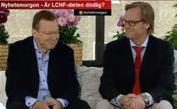
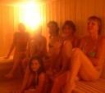
Norwegians perception of our neighbours
Danes
Tough in business
Direct
Friendly, open
Liberal
Swedes
Formal, bureaucratic
Polite
Traditional
Decent and «boring» - Volvo
superior
Finnish people
Silent and serious
Social in an odd way
Thrustworthy
«sisu». sauna

Slide 4
Now the boring stuff…….

Slide 5
The travel trade players in Norway

Slide 6
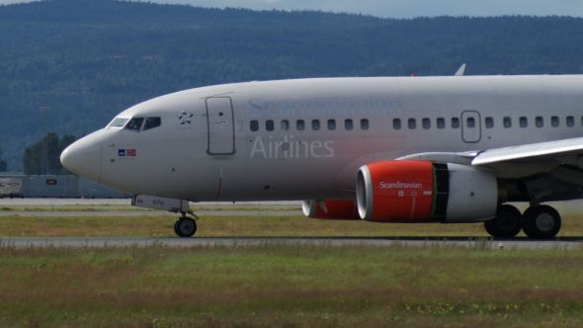
The Norwegian market & trends in general:
Approx 5 mill inhabitants. 65% go abroard during their main holiday (end June – mid-August). An increasing number will go on long vacations in winter period (Nov – March).
Travels to other destinatons than the Mediterranian are slowly increasing. Thailand, Caribbean, USA / the Americas and South Africa benefits from this.
LCC’s stimulates to continued growth in city-breaks/week-end travels.
On-line sales are increasing, estimated average 75% in 2014.
Christmas and Easter vacations are mostly spent with family and/or friends. But even here, we see an increase in outgoing travels.
Families with children and people aged 65 + tends to stay more in Norway / Scandinavia during holidays than other groups.

Slide 7
Leisure travels in Norway – general trends in demand and purchase:
Individual travels:
Booked via agents vs travel service providers directly :60/40 50/50
All kind of products and destinations
Package travels
Approx 1.300.000 charter pax p.y. Approx 870.000 during summer season. Mediterranean most popular.
General trends in demand:
Outgoing leisure travels increase approx 3% p.y. – signs of flattening. 5 mill travels p.y. at present.
«Sun and beach» appeals to the majority. But in addition:
Content (culture, history, activities, nature etc)
Activities ( sports, excurtions)
«The good story to tell» - exciting updates on FaceBook
Flexibility: Tailormade travels, unless «sun & beach» is most important
Value for money
Social medias important in planning, promotion and information – and booking

Slide 8
The Norwegian population segmented by age

Slide 9
The Norwegian population segmented by age II

Slide 10
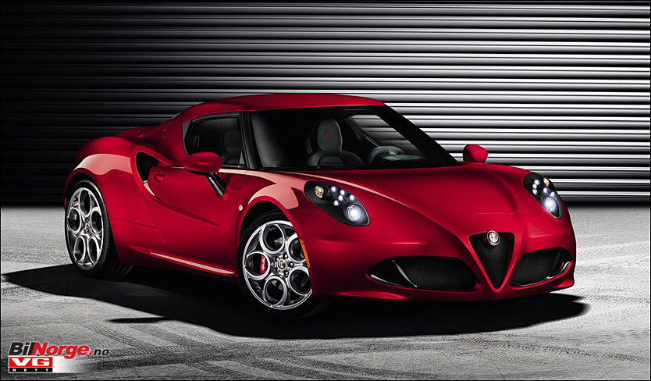
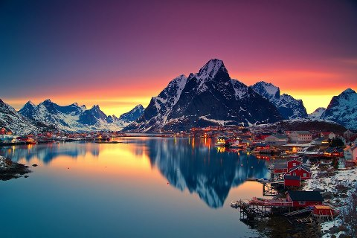
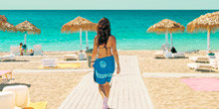
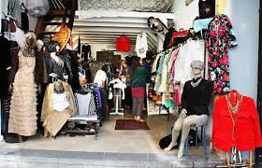
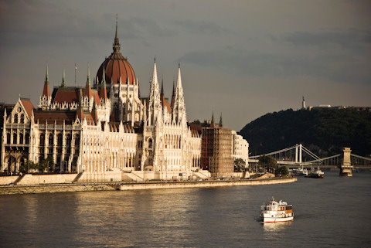
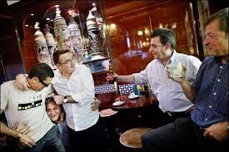
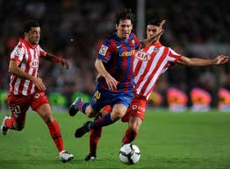
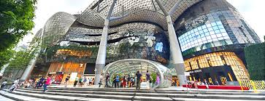
The vacation dreams inside the Norwegian tourists’ heads…..

Slide 11
Vacation plans 2014
n=1900/1900
n=1000

Slide 12
Where do you plan to spend your winter vacation?
Where to go during winter holiday? (multiple answers possible)
n=477/493/287

Slide 13
What is the purpose with winter vacation?
(up to three answers)
n=477/493/287

Slide 14
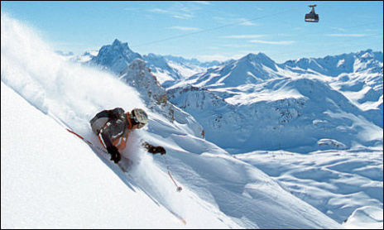
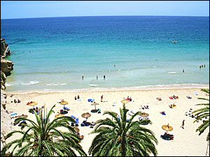
Vinter vacation with other words
School holiday week 8 / 9: Family focused
Norwegian tradition: Ski & snow
But an increasing number flee from the winter to «the south» : Canary Islands, Thailand
The age group 40 – 50 travel abroad more than others
The holiday that Norwegian can opt out if necessary

Slide 15
Where to stay during Easter??
(multiple answers possible)
n=631/670/406

Slide 16
The purpose with Easter vacation?
(up to three answers)
n=631/670/406

Slide 17
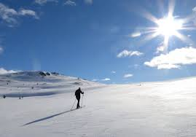
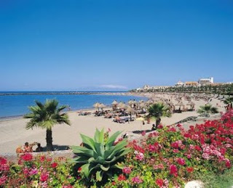
Easter Vacation with other words:
Late/early Easter is of some importance regarding vacation plans
The same goes for the winter weather prior to
EasterEaster is «first sign of Spring»
Family holiday – 50% stays at home, 25% in the mountains, 25% abroad

Slide 18
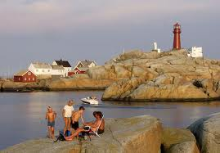
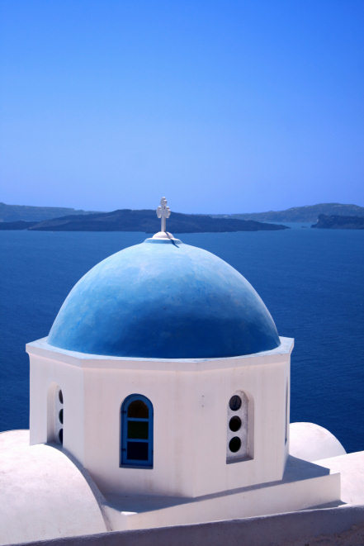
Summer holiday (June 20th – Aug 15th)

Slide 19
Where will you most likely spend most of your summer holiday?
(multiple answers possible)
n=1330/1388/741

Slide 20
Your purpose with summer vacation?
(up to three answers)
n=1330/1388/741

Slide 21
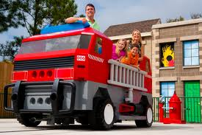
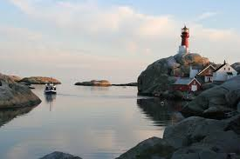
Summer vacation with other words:
The most important vacation through the year
Both in Norway and abroad (65%)
Denmark (families with children), Greece, Turkey, Spain
Last years’ summer weather affects this year’s planning
Budget issues: What kind of travel, not «travel or not to travel»..
Basic needs – «standard solutions»

Slide 22
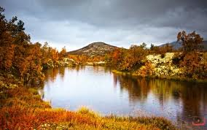
Autumn vacation (beginning of october – week 40/41)

Slide 23
Where to stay during autumn vacation (start of October)
(multiple answers possible)
n=415/393

Slide 24
The puropse with Autumn Vacation
Up to three answers possible
n=415/393

Slide 25
Autumn vacation with other words:
School holiday – originally designed for farmers’ needs for child labour during harvest time
«in between» summer and winter travel plans
Norwegians nature/mountains
Hunting, mushrooms,
«Vacation without plans»

Slide 26
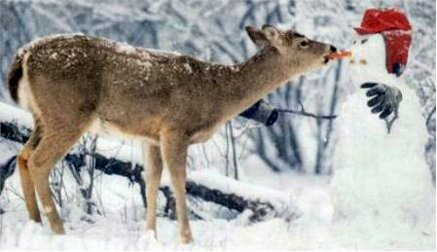
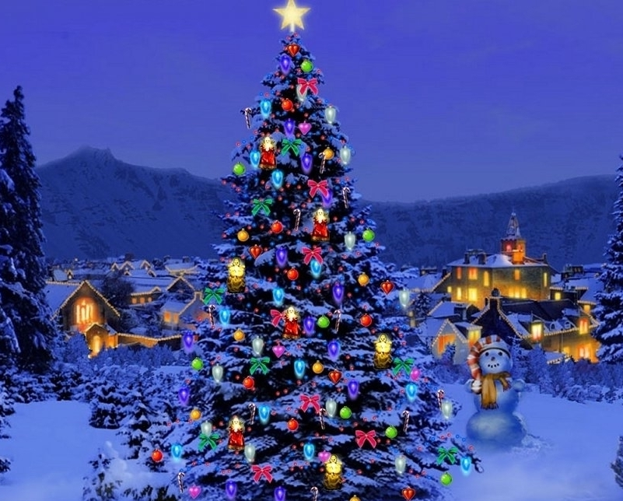
Christmas/New Year

Slide 27
Where will you spend the Christmas – New Year holiday?
(multiple answers possible)
n=553/586

Slide 28
Purpose with Christmas/New Years vacation
(up to three answers)
n=553/586

Slide 29
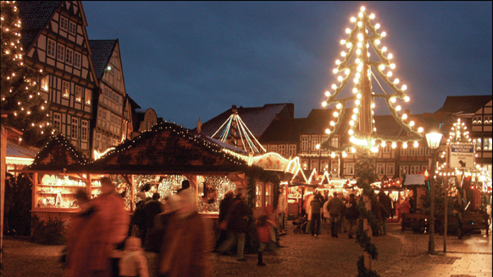
Christmas / New Years vacation in other words:
Most Norwegians stay at home or with family
Christmas Eve in Norway – new year abroad
Christmas AND New year abroad’
First week of January abroad
Pre-Christmas travels very popular – Christmas markets in Europe, shopping, culture, nostalgia
Estimaded 200.000 pax on such trips!

Slide 30
Other vacations (not school holiday)
How many days will you spend on such vacations?
n=379/451

Slide 31
Where will you stay on such vacations?
(multiple answers possible)
n=379/451

Slide 32
What is the purpose with such vacations?
(up to three answers)
n=379/451

Slide 33
Up, up, and away……..
Where do Norwegians go on their vacations? Multiple answers possible

Slide 34
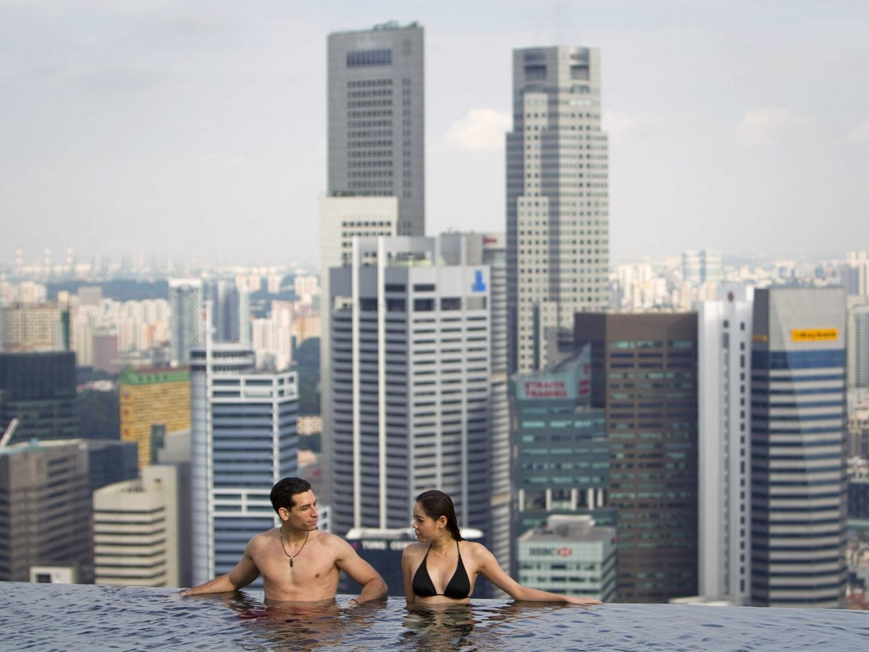
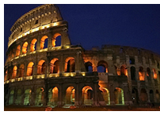
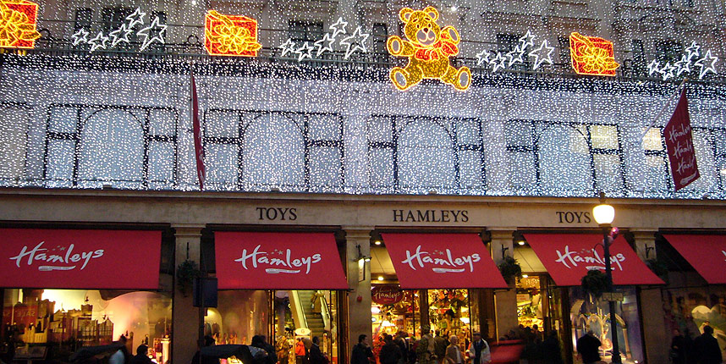
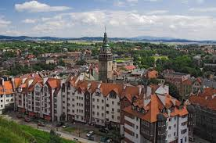
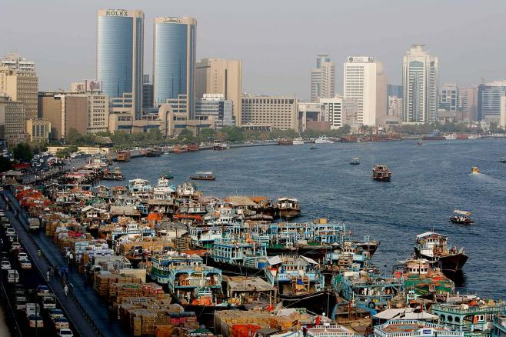
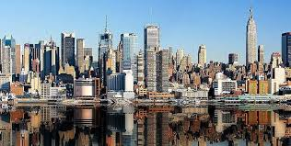
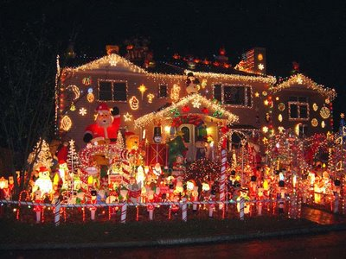
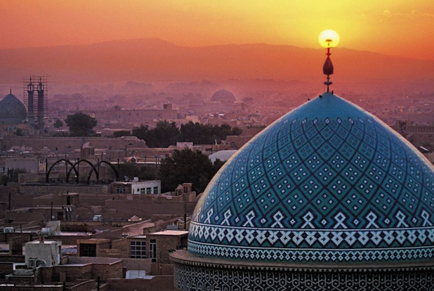
The «bonus» vacation

Slide 35
How many weekend-trips du you think you will have in 2014?
n=1900

Slide 36
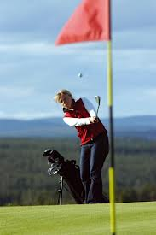
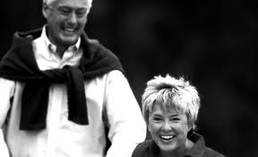
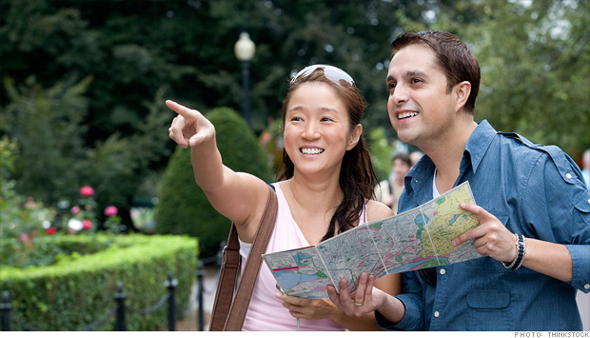
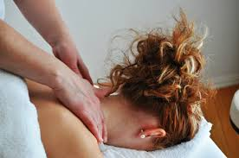
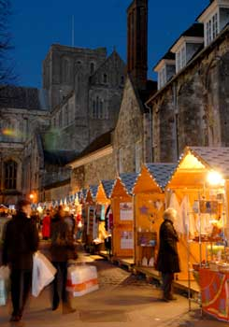
Personal motivation and needs

Slide 37
«Are you planning to go on one or more vacations in 2014 in order to persue a personal interest?
(multiple answers possible)
n=1900/1900

Slide 38
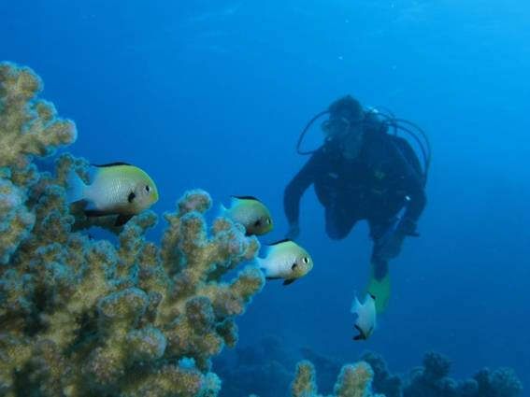
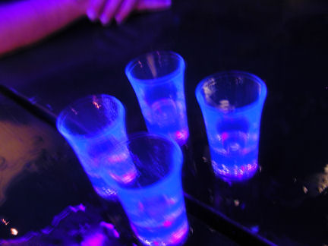
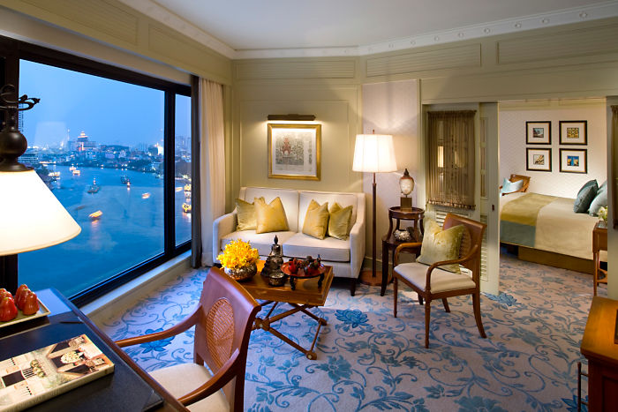
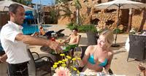
We expect our vacations to be GREAT….

Slide 39
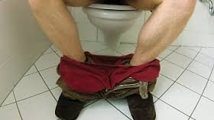
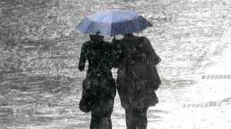
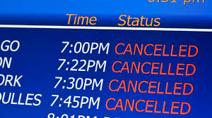
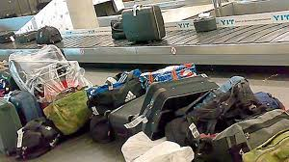
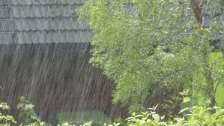
But our expectations for our vacations aren’t always met..

Slide 40
Rating of quality and content
How important are the following elements for your evaluation of your vacation? (scale 1 – 5)
n=1900

Slide 41
Importance vs satisfaction
n=1900

Slide 42
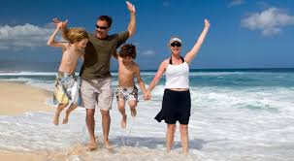
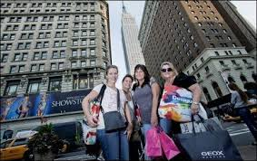
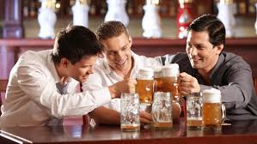
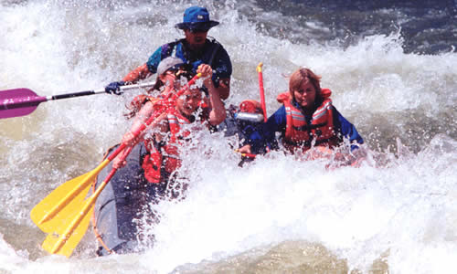
General market behaviour: Age 20 - 45
Summer holiday: Family needs decide where to go, especially when children are small
«Other vacations»: Women and men go on week-end trips with friends. Shopping, culture – football, beer. Women: Italy, Nice, Rome and London. Men: Dublin, London – or up in the countryside anywhere cheap.
High spenders vs budget travellers: Value for money. But «value» differs…
Dominant group on social medias next to teenagers.
«Daring, spending» when children are at home

Slide 43
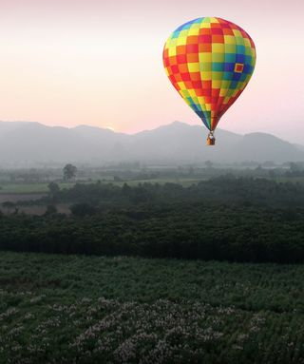
General market behaviour; Age 45 - 65
Experienced travellers.
Want to do all the things they coulden’t afford or had time for when younger
Personal demands more visible in behaviour:
New spouse…
…or trying to «heaten up» the old one
Perserving their «youth» – training, fitness
But also demand for the «good life»
Good economy, but price still matters
Nostalgia/hobbies
Grandparents + grandchildren

Slide 44
General market behaviour: Age 65 - 80
Health concerned
Comfort before excitement
«Been there, seen that, done that»
«Do we really have to go on this trip?»

Slide 45
SUMMARY – MAIN DEMANDS VS AGE CATEGORIES
20-25:
“back packers” vs - - “partyhunters” – free to travel, want either intellectual stimulation or “fun”, Ibiza or Tibet.
25 - 40:
Family with small children. Denmark or Turkey, maybe Thailand. Safety, comfort.
40 - 65:
Still young – and with good private economy. Want to do all the things they coulden’t afford or find time to at age 35. Either the “good life in the sun” or exploring the world.
65 – 85:
Second home in Norway/France/Spain, or cruise in the Caribbean.

Slide 46
Norwegians’ perception of «the world»
«Norway, Scandinavia, Germany/UK/France, «The south», Africa, USA, Thailand, China and some other countries»
«Home = safe, neighbouring countries are almost safe and the others… Good luck!»
«People who cannot speak English, cannot be thrusted»
«Freshwater in other countries than Norway cannot be drinken from the tap»

Slide 47
Norwegians’ perception and knowledge of «Poland»: Not too impressive…
Former communist country
Some cities worth visiting (Warsaw, Krakow, Gdansk)
Suffered badly during the World War II, especially their jewish population
Cheap alcohol, shopping opportunities, Casinos
Flat countryside, a little «dull» and «grey»
Old fashioned infrastructure
Alternative route to Austria and the East Mediterranean for those who travel by car
Large country!
Bordering Russia….
Part of Germany in the Middel Age?

Slide 48
Norwegians’ perception of the Polish people
Lots of «handymen» offering services in Scandinavia
Some orginazed crime in Scandinavia
Powerty and welth side by side
Language issues – English not that good even in tourist areaes
Gentle and welcoming people,
But taxi drivers and some waiters cannot be thrusted

Slide 49
Key features of Norwegians’ personalities (not approved by our self-branding authorities)
«I am interesting» , well, I will at least TRY to be interesting…
«I am goodlooking» – well, I will TRY to be looking good…
I am young and fit.. well, I will use whatever it takes to at least LOOK young and fit
I am financially responsible despite of my fat wallet… at least, I will ACT as I am rich and responsible
As a Norwegian, I am entitled to a certain respect

Slide 50
The mind of the average Norwegian is a field waiting for seed :
«Poland is large, dull and grey» and offer no special assets when it comes to nature
But with some interesting cities
The Polish people, infrastructure and daily life are still marked by decades of comunism
Norwegians generally think of Poland as an option for city breaks, shopping and Christmas Markts
There is a great potential for extending Norwegians knowledge of and interest in Poland!
Cosmetic, medical and dental «tourism» is booming. What can Poland offer?

Slide 51
Good luck to you all!

